Slide 1
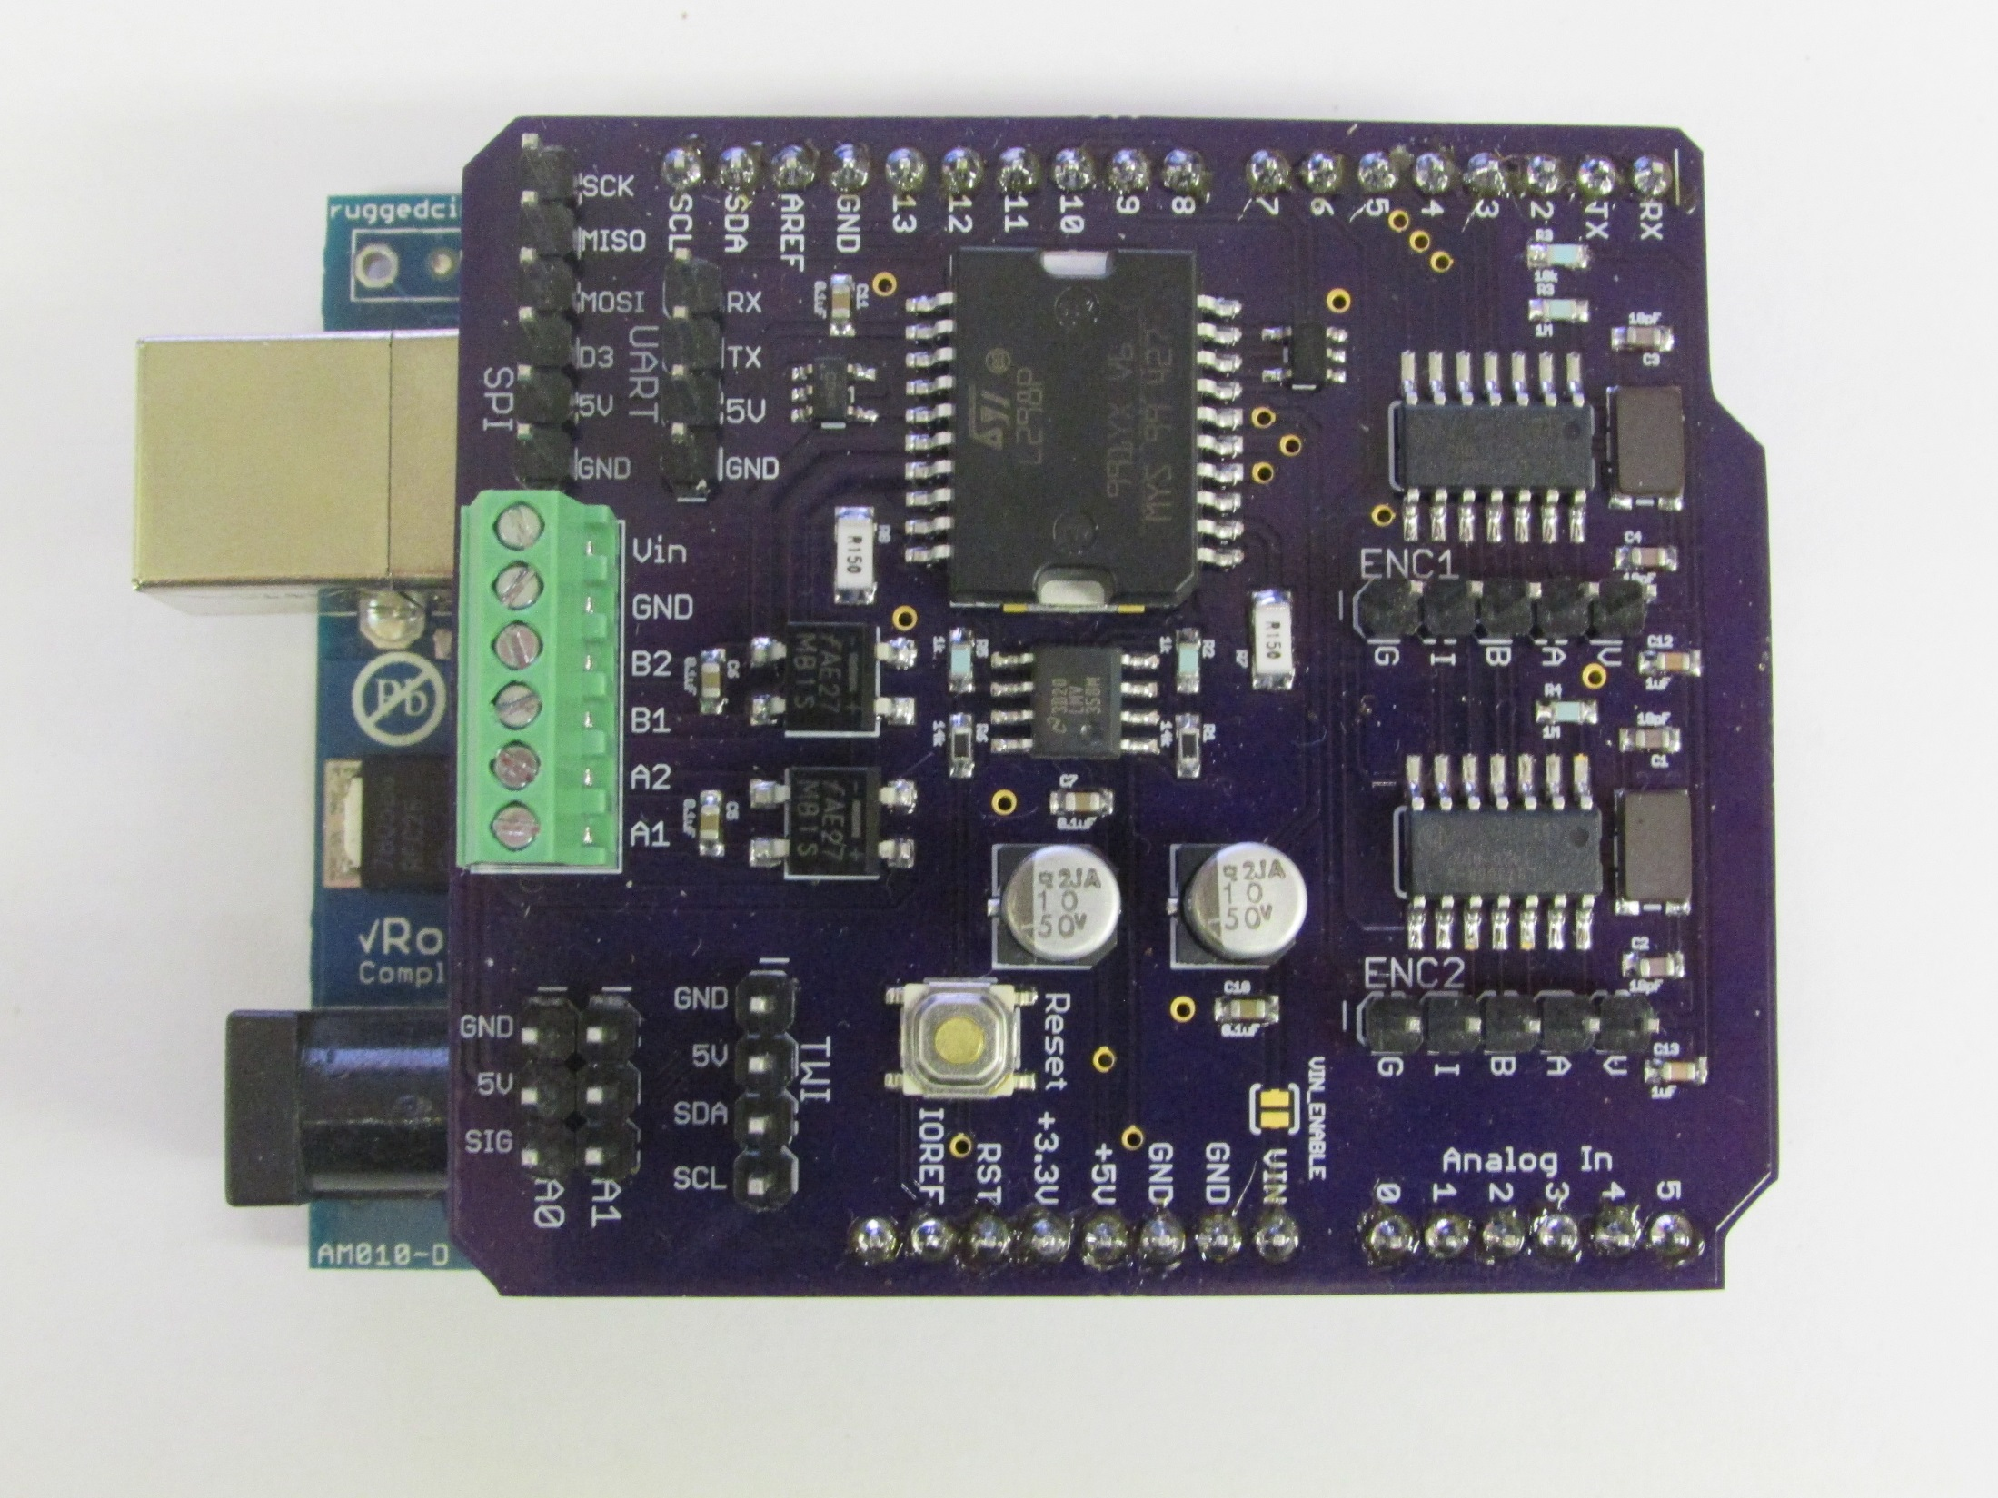
SPI
UART
Encoder 1
Power In and
Motors Out
Encoder 2
Analog & PWM
Reset Button
Vin Enable
I²C

